Slide 1
Object Detection
Group J
Junaid Suleman, Percy Jia, Wenbo Wu

Slide 2
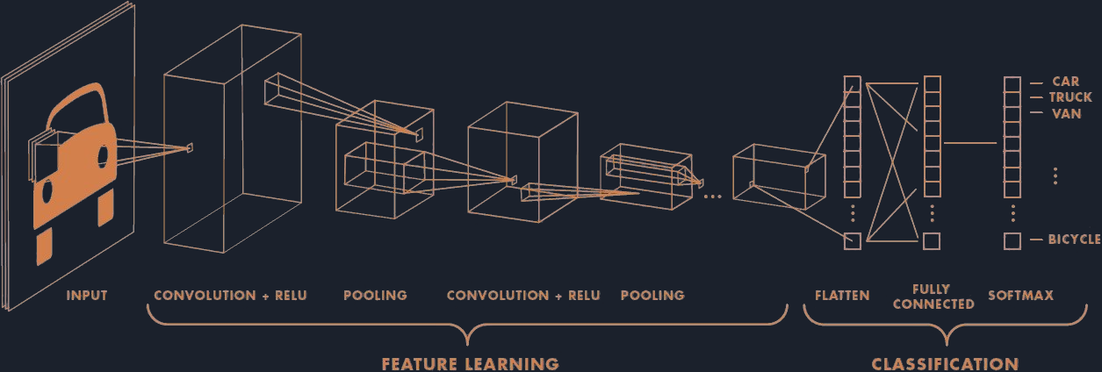
Convolutional Neural Networks (CNN)
Notes:
To start off
A Convolutional Neural Network also known as a ConvNet or CNN is one of the representative algorithms in Deep Learning. Which can take in an input image, assign importance (learnable weights and biases) to various aspects/objects in the image and be able to differentiate one from the other. The pre-processing required in a ConvNet is much lower as compared to other classification algorithms. While in other methods filters are hand-engineered, with enough training, ConvNets have the ability to learn these filters/characteristics.
Convolutional layer, Pooling layer and Fully -connected layer

Slide 3
Algorithms
Fast R-CNN
Faster R-CNN
You Only Look Once (YOLO)
Histogram of Oriented Gradients (HOG)
Single Shot Detector(SSD)
Spatial Pyramid Pooling
R-CNN
R-FCN
Notes:
There are the various algorithms that can be used for object detection.
Faster RCNN is the upgraded version of Fast RCNN which is an upgraded version of RCNN.
Similar to RCNN is the YOLO algorithm that is based on CNN’s
Histogram of oriented gradients (HOG) is basically a feature descriptor that is utilised to detect objects in image processing and other computer vision techniques.
SSD is a method for detecting objects in images using a single deep neural network. The SSD approach discretises the output space of bounding boxes into a set of default boxes over different aspect ratios. After discretising, the method scales per feature map location. The Single Shot Detector network combines predictions from multiple feature maps with different resolutions to naturally handle objects of various sizes.
Spatial Pyramid Pooling (SPP-net) is a network structure that can generate a fixed-length representation regardless of image size/scale. Pyramid pooling is said to be robust to object deformations, and SPP-net improves all CNN-based image classification methods.
Region-based Fully Convolutional Networks or R-FCN is a region-based detector for object detection. Unlike other region-based detectors that apply a costly per-region subnetwork such as Fast R-CNN or Faster R-CNN, this region-based detector is fully convolutional with almost all computation shared on the entire image.
R-FCN consists of shared, fully convolutional architectures as is the case of FCN that is known to yield a better result than the Faster R-CNN. In this algorithm, all learnable weight layers are convolutional and are designed to classify the ROIs into object categories and backgrounds.

Slide 4
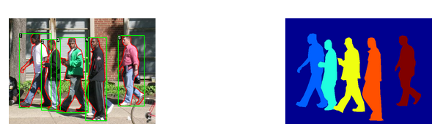
Dataset
Penn-Fudan Database for Pedestrian Detection and Segmentation
Notes:
The dataset we used for our Project is the Penn-Fudan Dataset, it has fully labeled bounding boxes as well as segmentation masks.
The objects we are interested in these images are pedestrians and each image will have at least one pedestrian in it.
The heights of labeled pedestrians in this database fall into [180,390] pixels. All labeled pedestrians are straight up.
There are 170 images with 345 labeled pedestrians, among which 96 images are taken from around University of Pennsylvania, and other 74 are taken from around Fudan University.

Slide 5
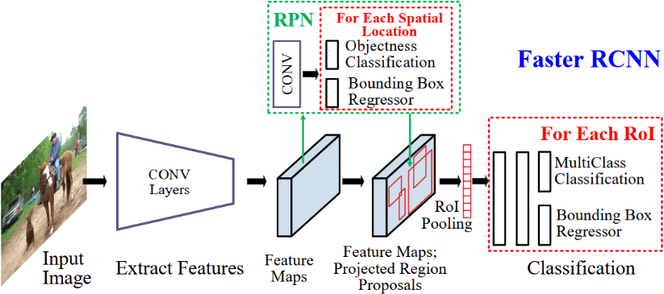
Faster-RCNN
Notes:
Faster R-CNN is an object detection algorithm that is similar to R-CNN but utilises the Region Proposal Network (RPN) that shares full-image convolutional features with the detection network.It does that in a more cost effectively than either R-CNN and Fast R-CNN.
It takes the image extracts its features with a CNN and feeds that into the RPN which is []
An RNN or Region Proposal Network is basically a fully convolutional network that simultaneously predicts the object bounds as well as objectness scores at each position of the object and is trained end-to-end to generate high-quality region proposals, which are then used by Fast R-CNN for detection of objects.
How it differs:
The first module generates 2,000 region proposals using the Selective Search algorithm and feeding the extracted features into an SVM
Proposed a new layer called ROI Pooling that extracts equal-length feature vectors from all proposals (i.e. ROIs) in the same image. → Fast RCNN
Faster R-CNN shares computations (i.e. convolutional layer calculations) across all proposals (i.e. ROIs) rather than doing the calculations for each proposal independently.

Slide 6
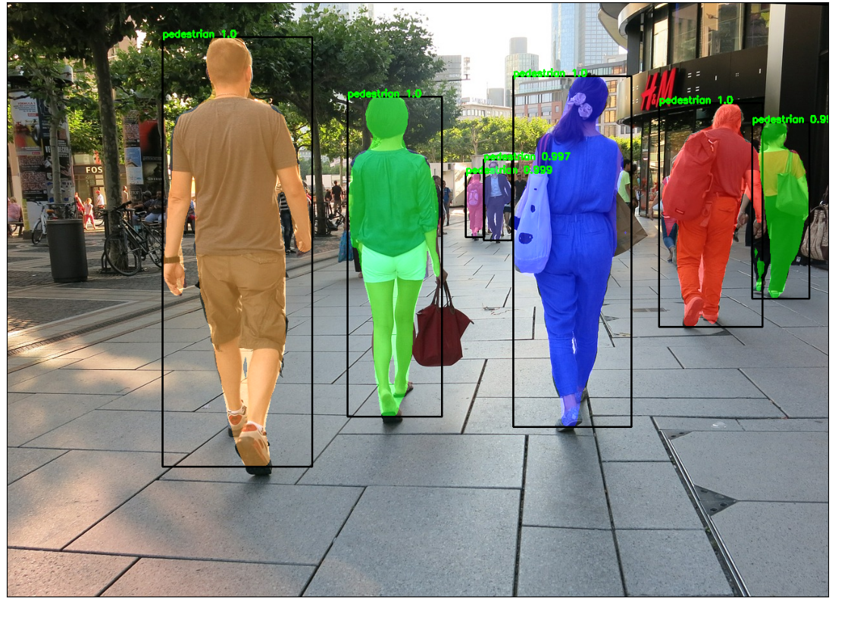
Results - Faster CNN with Segmentation
Notes:
The image was never seen by the dataset while training.

Slide 7
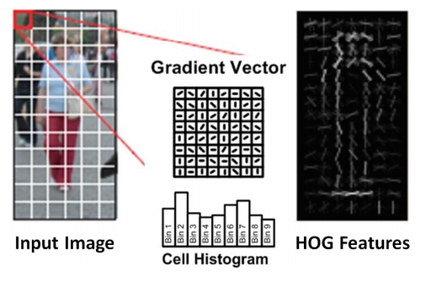
Histogram of Oriented Gradients (HOG)
Notes:
Histogram of oriented gradients (HOG) is basically a feature descriptor that is utilized in objects detection. It process the image and outputs The Histogram of oriented gradients descriptor technique includes occurrences of gradient orientation in localised portions of an image, such as detection window, the region of interest (ROI), among others.
Add personal notes here?? → Percy
HOG is an efficient way to extract gradient features out of the images.
The gradient features includes the magnitudes and directions of the gradient of the pixels
By saying feature After normalizing the pixel values, comput

Slide 8
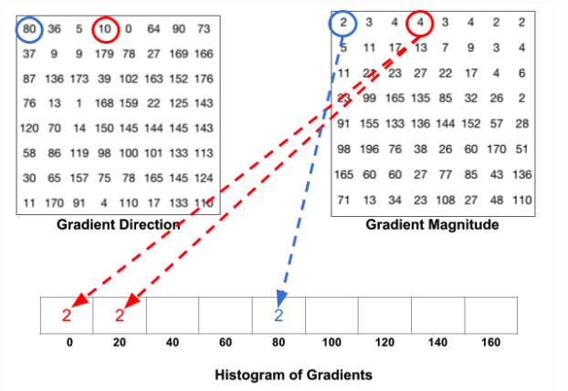
Notes:
Robustness --- To handle small distortion with splitting gradient magnitude into two bins of the histogram.
For better robustness, if the direction of the gradient vector of a pixel lays between two buckets, its magnitude does not all go into the closer one but proportionally split between two. For example, if a pixel’s gradient vector has magnitude 8 and degree 15, it is between two buckets for degree 0 and 20 and we would assign 2 to bucket 0 and 6 to bucket 20.
This interesting configuration makes the histogram much more stable when small distortion is applied to the image.

Slide 9
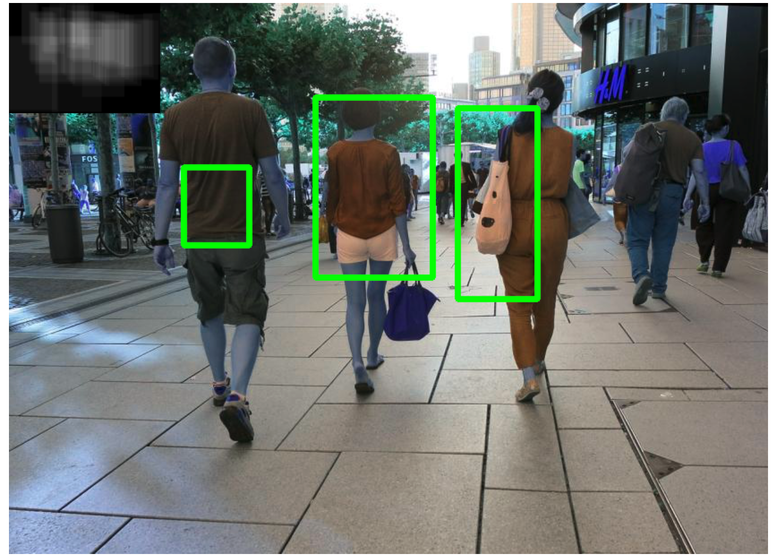
Results - HOG descriptor with an SVM
Notes:
Needs a lot more training samples to go anywhere near either Mask-RCNN or Yolo
Didn’t put any graphs of validation and training scores in the image because would better fit in a report with a more detailed explanations.
Improvements:
Hard-negative mining:
train on the false-positive patch
use a image pyramids

Slide 10
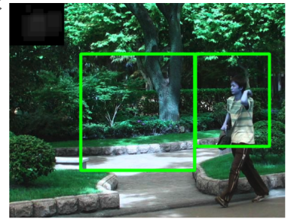
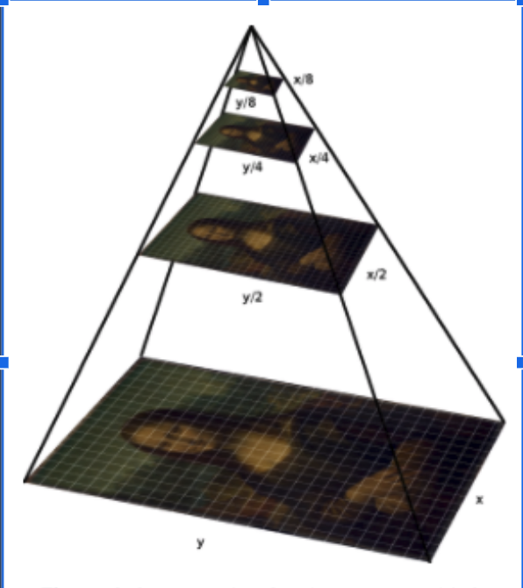
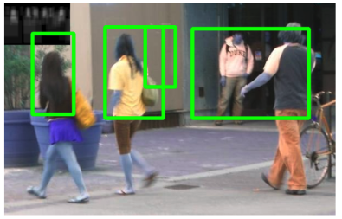
Notes:
Improvements:
Hard-negative mining:
train on the false-positive patch
use a image pyramids
Rotation on the training images

Slide 11
Steps of creating a HOG-based SVM Classifier:
step 1: prepare training data, the training data need to be same size images for all of them, otherwise we resize them using skimage or opencv, because we are trying to construct a feature vector.
secondly, the training images need to capture only those thing you want to learn on the SVM, in our case it is the pedestrians, so no other obstacles obscuring the person's shape (so I made the training data from cropping those bounding box)
step 2: construct the feature vector, for example: concatenate the HOG of the images and np.histogram of the color channels, and the spatial features.
step3: train the SVM. This is same as our assignment 2, but we are having two labels, pedestrians (positive) and non-pedestrian (negative)

Slide 12
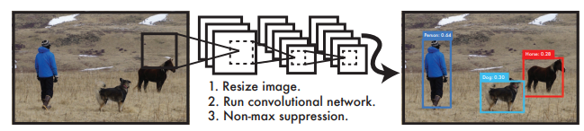
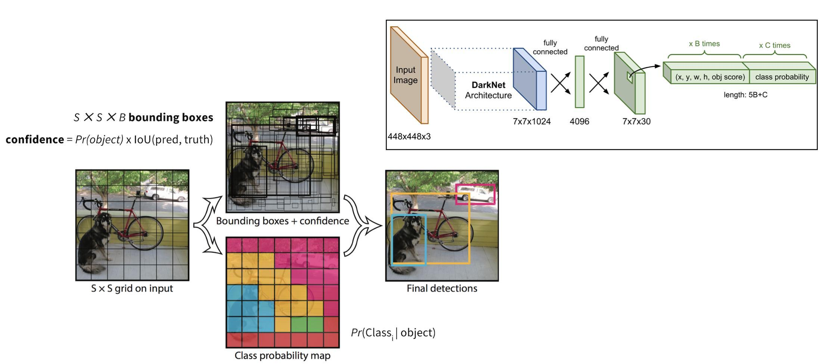
YOLO(You Only Look Once)
Notes:
You Only Look Once or YOLO is one of the popular algorithms in object detection used by the researchers around the globe. According to the researchers at Facebook AI Research, the unified architecture of YOLO is extremely fast in manner. The base YOLO model processes images in real-time at 45 frames per second, while the smaller version of the network, Fast YOLO processes an astounding 155 frames per second while still achieving double the mAP of other real-time detectors. This algorithm outperforms the other detection methods, including DPM and R-CNN, when generalising from natural images to other domains like artwork.
Personal Notes go here → GPEddie
YOLO is one of the most popular technique for object detection. It divides up the image into a grid of cells.

Slide 13
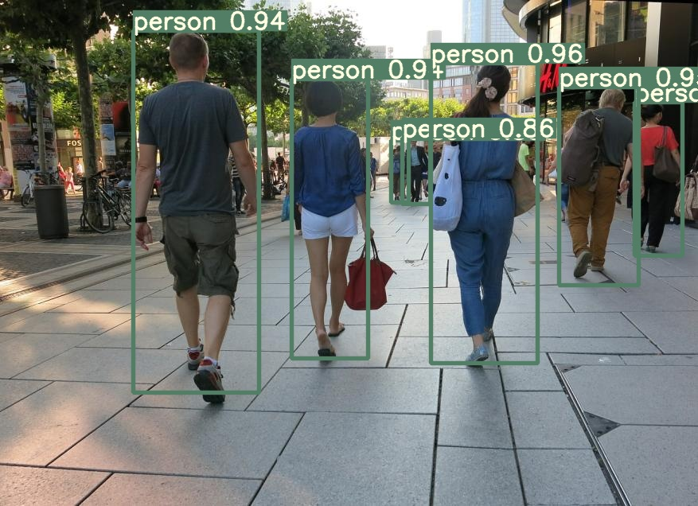
Results - YOLO without Segmentation

Slide 14
Advantages
Faster RCNN
YOLO
HOG
Higher detection quality (mAP) than R-CNN, SPPnet
Training is single-stage, using a multi-task loss
Training can update all network layers
No disk storage is required for feature caching
Superb speed, commonly used for real-time object detection
Outperforms the other detection methods, including DPM and R-CNN
Better performance of overall information
It is a highly generalized network
It is invariant to geometric and photometric transformations
Particularly suited for human detection.
Simplistic features, which makes the information they can easy to understand.

Slide 15
References
https://towardsdatascience.com/a-comprehensive-guide-to-convolutional-neural-networks-the-eli5-way-3bd2b1164a53
https://analyticsindiamag.com/top-8-algorithms-for-object-detection/
https://papers.nips.cc/paper/2015/file/14bfa6bb14875e45bba028a21ed38046-Paper.pdf
https://www.cv-foundation.org/openaccess/content_cvpr_2016/papers/Redmon_You_Only_Look_CVPR_2016_paper.pdf
https://software.intel.com/content/www/us/en/develop/documentation/ipp-dev-reference/top/volume-2-image-processing/computer-vision/feature-detection-functions/histogram-of-oriented-gradients-hog-descriptor.html
https://www.cis.upenn.edu/~jshi/ped_html/
https://blog.paperspace.com/faster-r-cnn-explained-object-detection/

